Slide 1
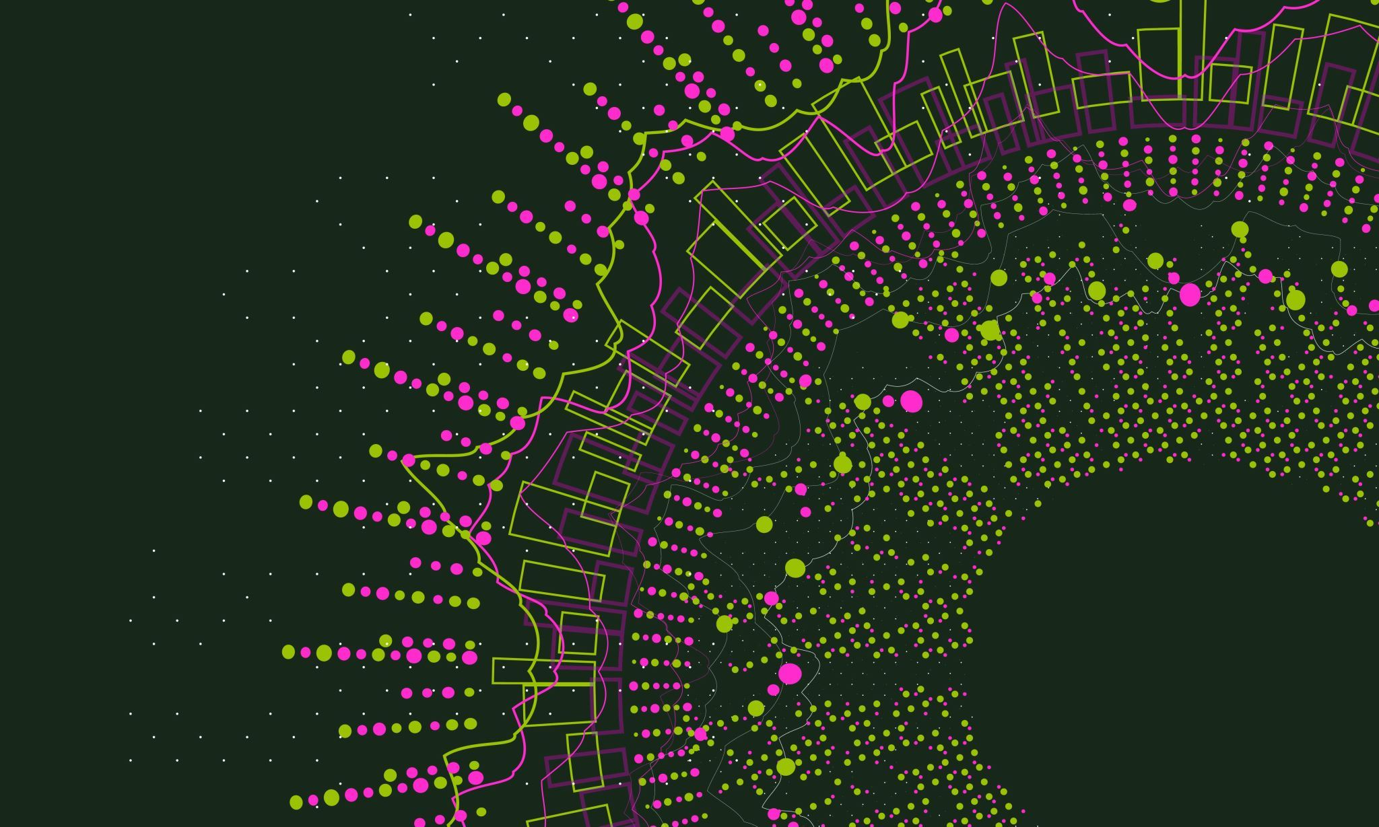
GUI Development and Design
Kailey Bergeron Afra Noman Anh Ngoc Cong Nguyen
Notes:
Raise your hand if you have used a gui
Raise your hand if you have created or design a gui

Slide 2
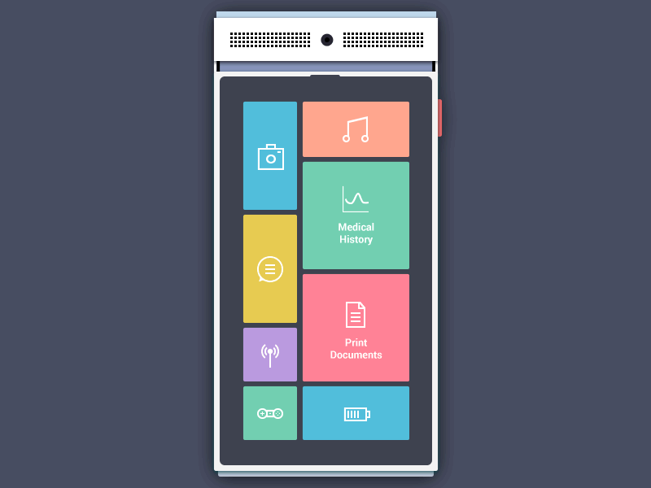
What is a Gui ?
GRAPHICAL USER INTERFACE (GUI)
GUI uses a computer’s processing capabilities to display information, allows the user to access information with greater ease.
Before this you needed codes and commands to use computer functions – command line interface (OS)
Three main parts of GUI program:
Frames; main window that contains the visual elements.
Codes; programming logic/instructions that defines functionality/behavior of GUI
Events; actions that trigger specific responses
Notes:
Kailey -
A GUI, or Graphical User Interface, is the part of a computer program or application that you interact with visually. Instead of typing commands, you can use buttons, icons, menus, and other visual elements to control the program. Think of it as the screen layout you see on a website or app, where you can click, tap, and drag things around to make things happen.
Point and click interface
For example, when you use a web browser, the tabs, back button, and address bar are all part of the GUI. It makes software easier to use because you don’t need to know any special codes—just point and click!
Also the example that the documentation used with the portolfio website, if you have created a portfolio website chances are you having created a gui/used a gui.
Also in relation to the API presentation, guis and apis go hand and hand as well.

Slide 3
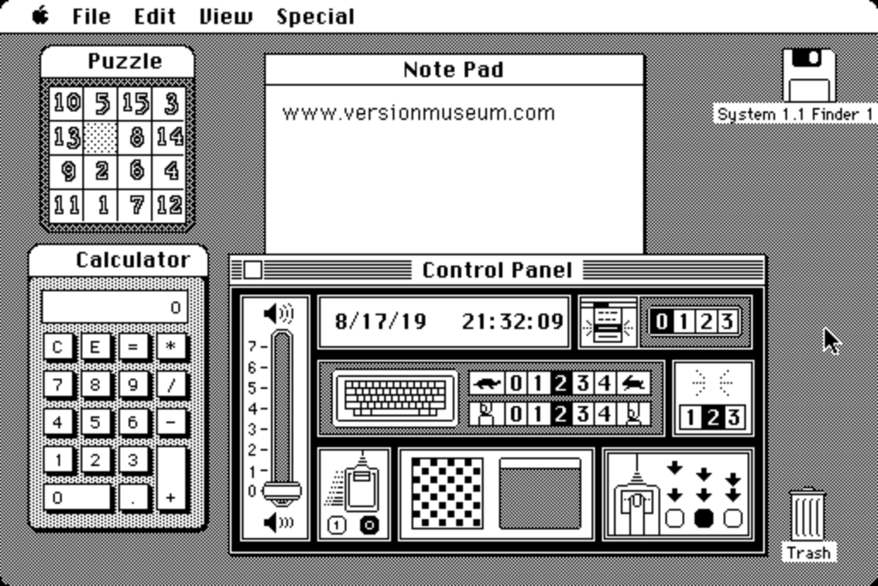
History of guis
1973: First GUI was created in 1973 by computer engineers at Xerox Palo Alto Research Center (PARC).
1984: Apple's Macintosh PC System 1 was the first personal computer with a mouse and GUI. Menu bar to access files, apps, and system features, a calculator, alarm clock, notepad, control panel for adjusting volume, date and time and mouse settings.
Notes:
Kailey -
After Many decades of research – started with a keyboard alone and computer, wanted to be able to move the cursor around the screen and user interaction. - The first GUI was created in 1973 by computer engineers at Xerox (Zi-Rox) Palo Alto Research Center (PARC). - But the first GUI for personal devices was Apple's Macintosh PC (released in 1984) and was the first commercially sold computer with a mouse and GUI. - As pictured there was a menu bar to access files, apps, and system features, a calculator, alarm clock, notepad, control panel for adjusting volume, date and time and mouse settings. As you can see many features are still used today.
Almost all desktops use a WIMP interface - windows, icons, menus, pointer
In addition, The development of the GUI led to the invention of the computer mouse. The first mouse was created by Douglas Engelbart in 1964 and was made out of wood!
Modern GUIs allow for multitasking by letting users open multiple windows simultaneously
GUIs are no longer confined to computers. They’re found in a wide variety of devices, including smartphones, ATMs, TVs, and even household appliances.

Slide 4
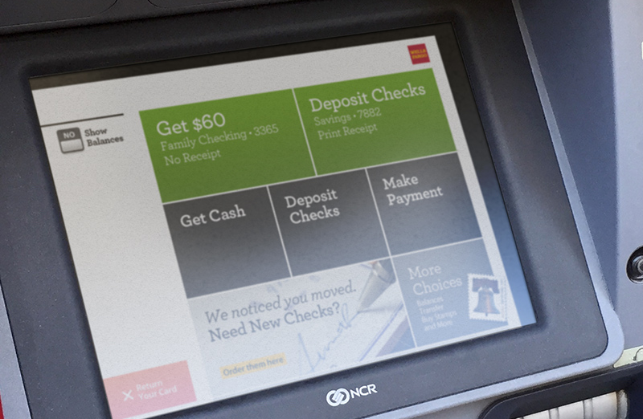
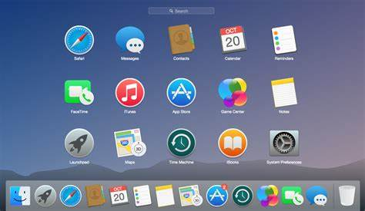
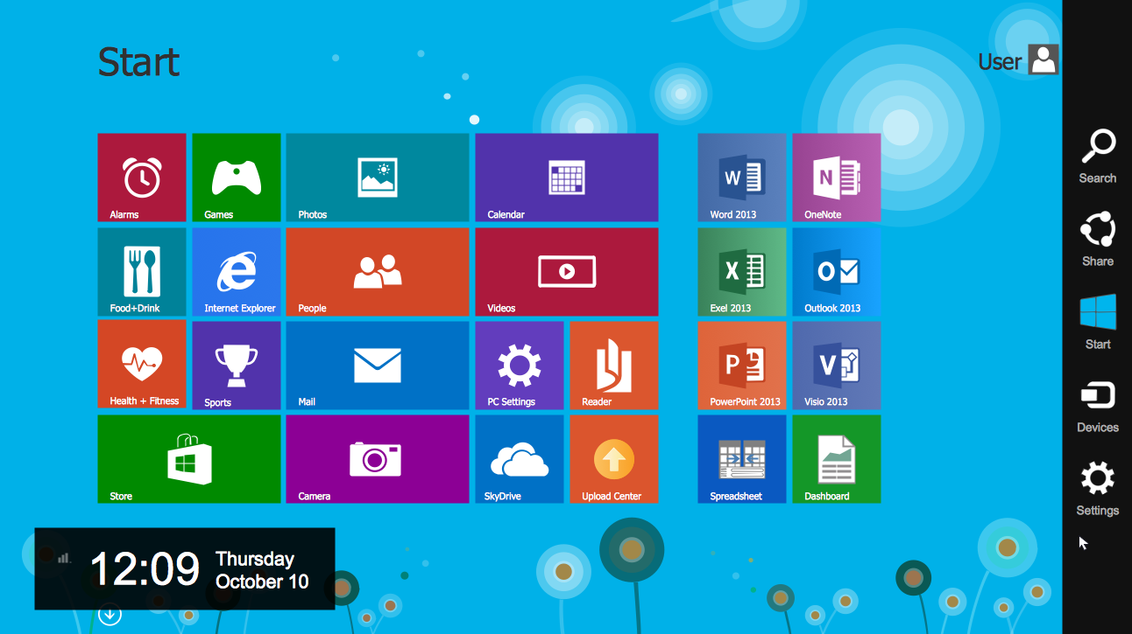
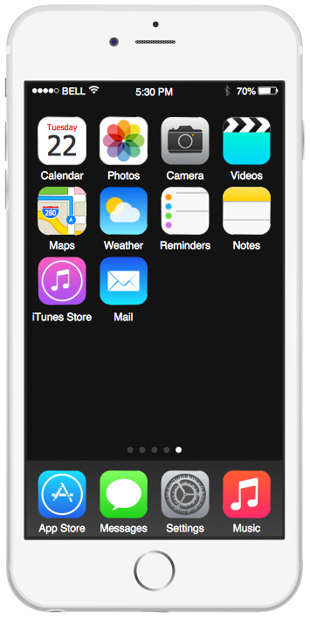
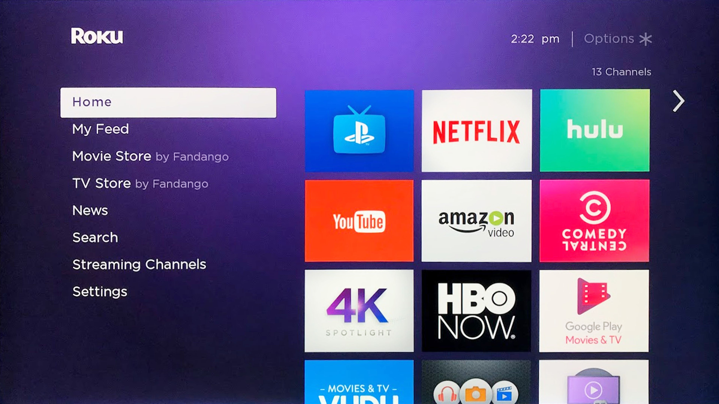
Guis now
Notes:
Mobile phones, smartvs, atms, smart home devices, vr, self service kiosks..

Slide 5
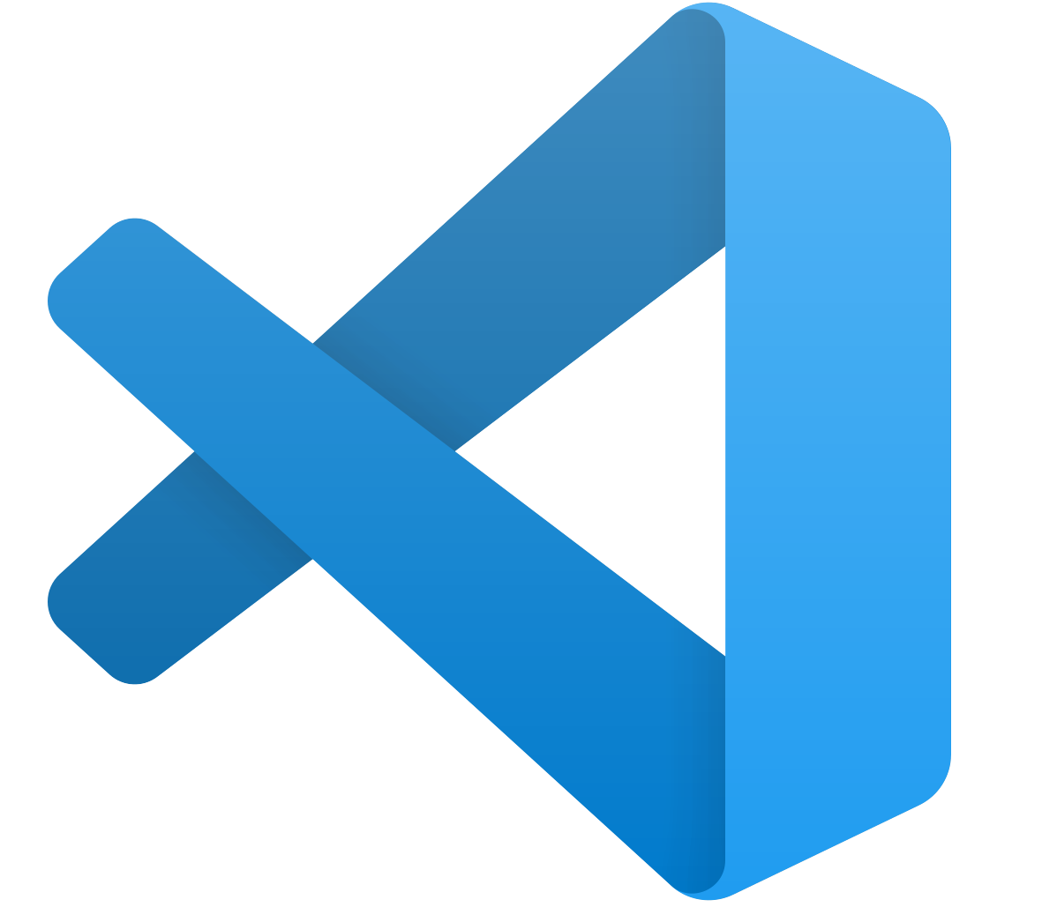

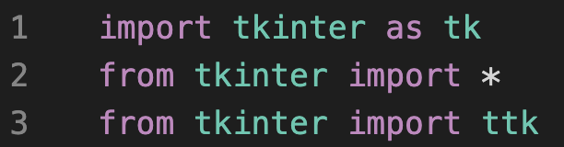
Set Up :
STEP 1: VS Code
STEP 2: Python
STEP 3: Tkinter
Notes:
Afra –
- Step 1 and 2 VS Code and Python should already be set up due to the IDE workshop.
Tkinter is already built into Python 3.x, so nothing is need except to import it.
Line 1 we import tkinter as well as ‘rename’ it tk so that it is easier to reference
Line 2 we import from tkinter all functions and built-in modules
Line 3 imports “themed Tkinter” which gives more modern looking widgets (adjusts to user os) than regular Tk widgets.

Slide 6
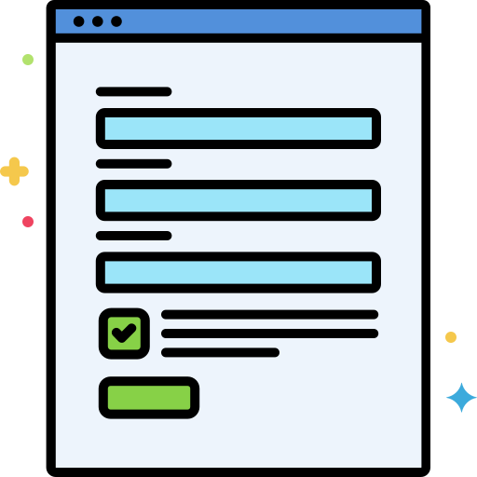
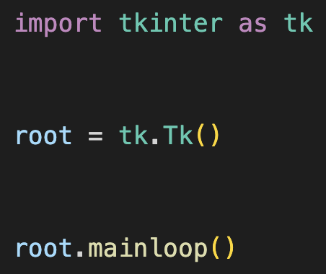
Intro to Tkinter
Standard GUI library for Python.
Highly recommended for beginners!
Three main parts:
The library
Main window
Main event loop
Notes:
Afra –
- Open-source, cross-platform widget toolkit utilized by various programming languages to construct GUI programs. Straightforward.
import tkinter as tk: imports the library and renames it as tk.
root = tk.Tk(): creates the main window where all the graphical components will be. Root, top, window.
root.mainloop(): enters the main event loop so an event triggers when a user interacts with it.

Slide 7
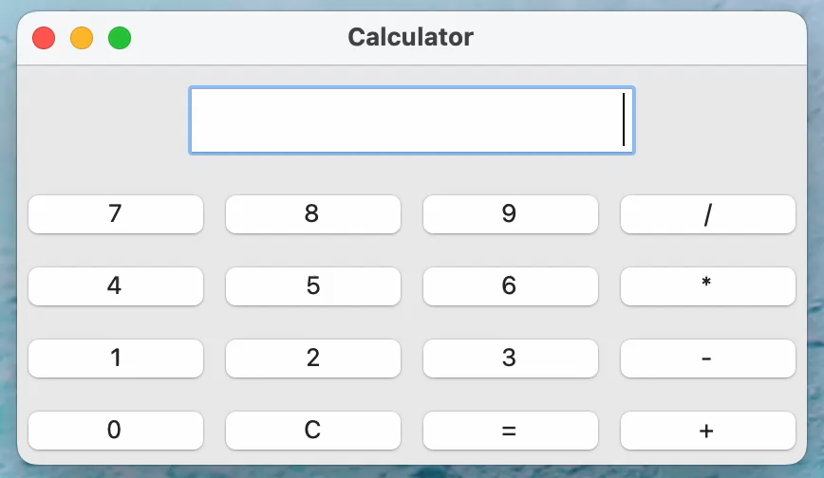
Calculator Gui Example
Notes:
The entry, buttons
Pressing buttons puts it into the entry widget. You can also manually type into entry widget.
Works with both light and dark mode.

Slide 8
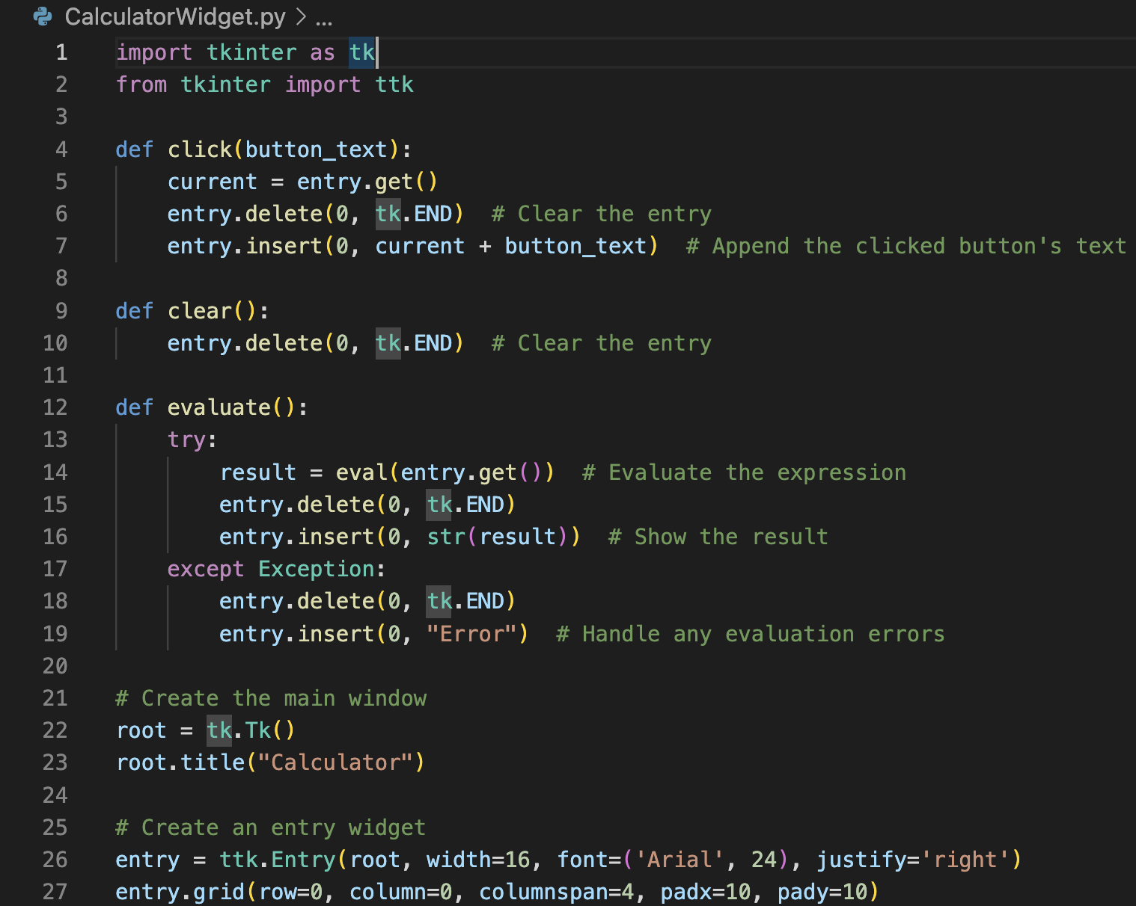
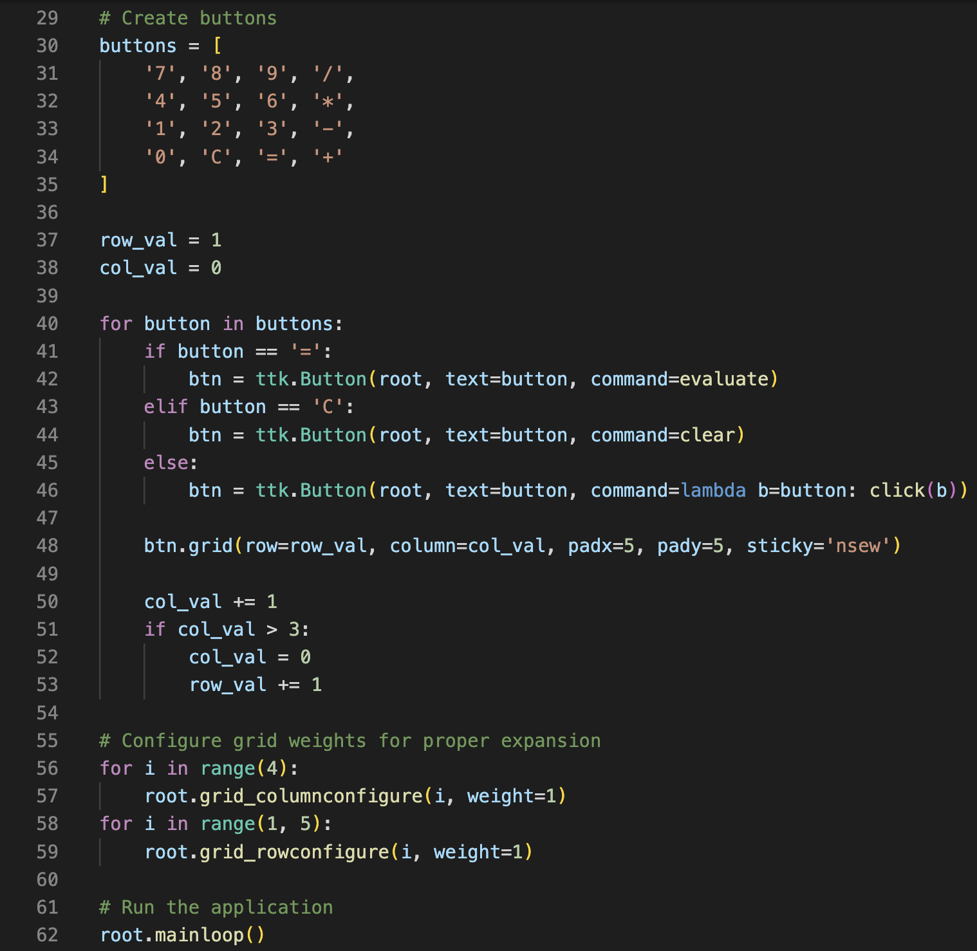
Calculator GUi code
Notes:
We imported tkinter and ttk. No need for to import everything with the asterik because it is a small application.
The green is tk. and ttk. Widgets.
Everything blue is from/provided by tkinter.
Eval() takes in whatever is in the entry widget, which can be put in by user or by pressing the buttons.

Slide 9
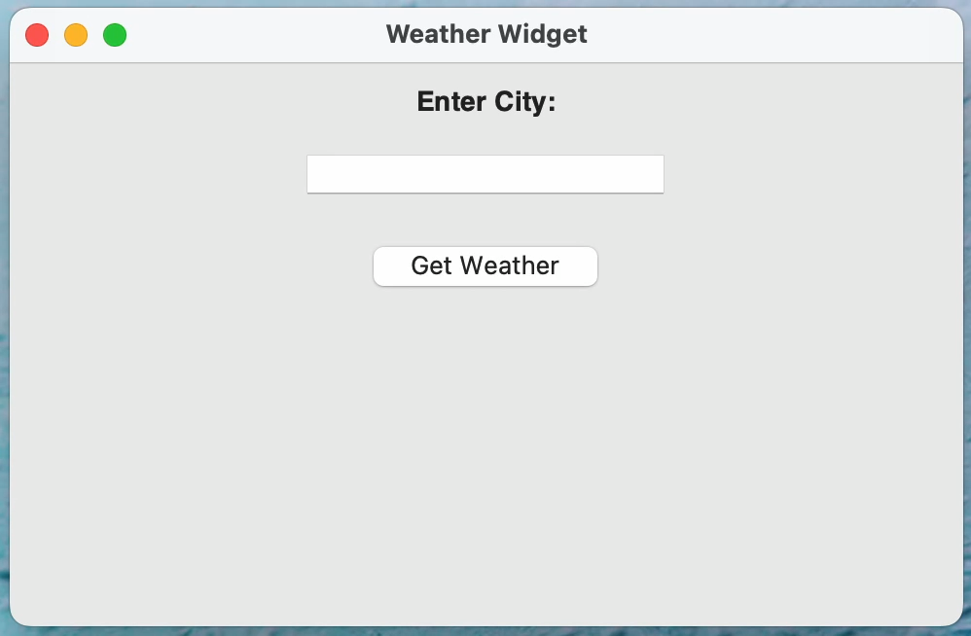
Weather GUi Example

Slide 10
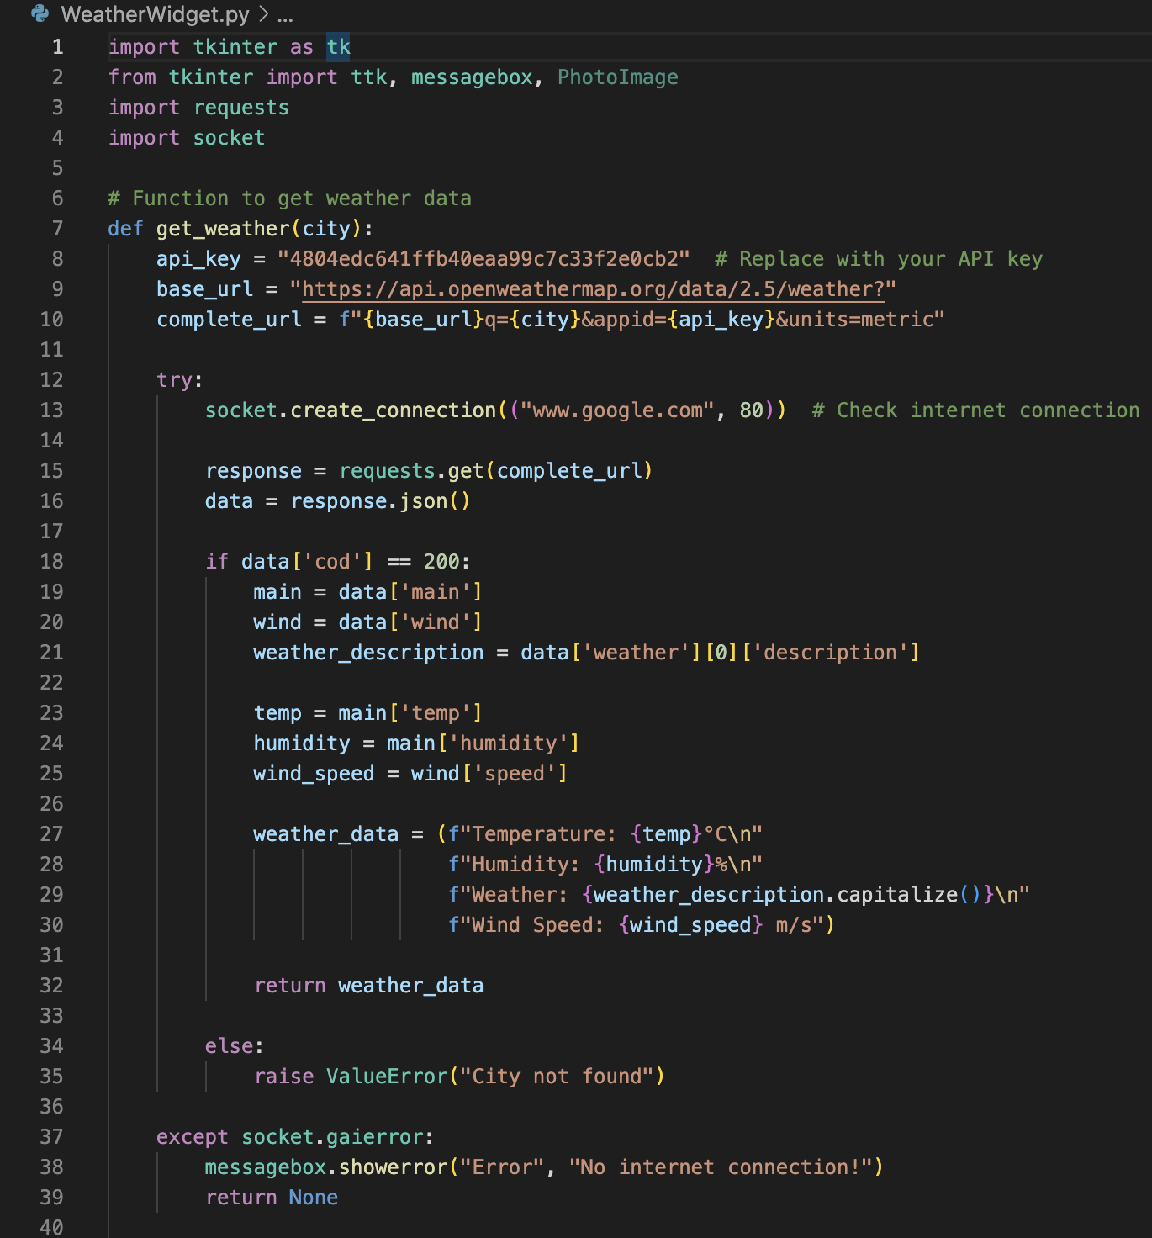
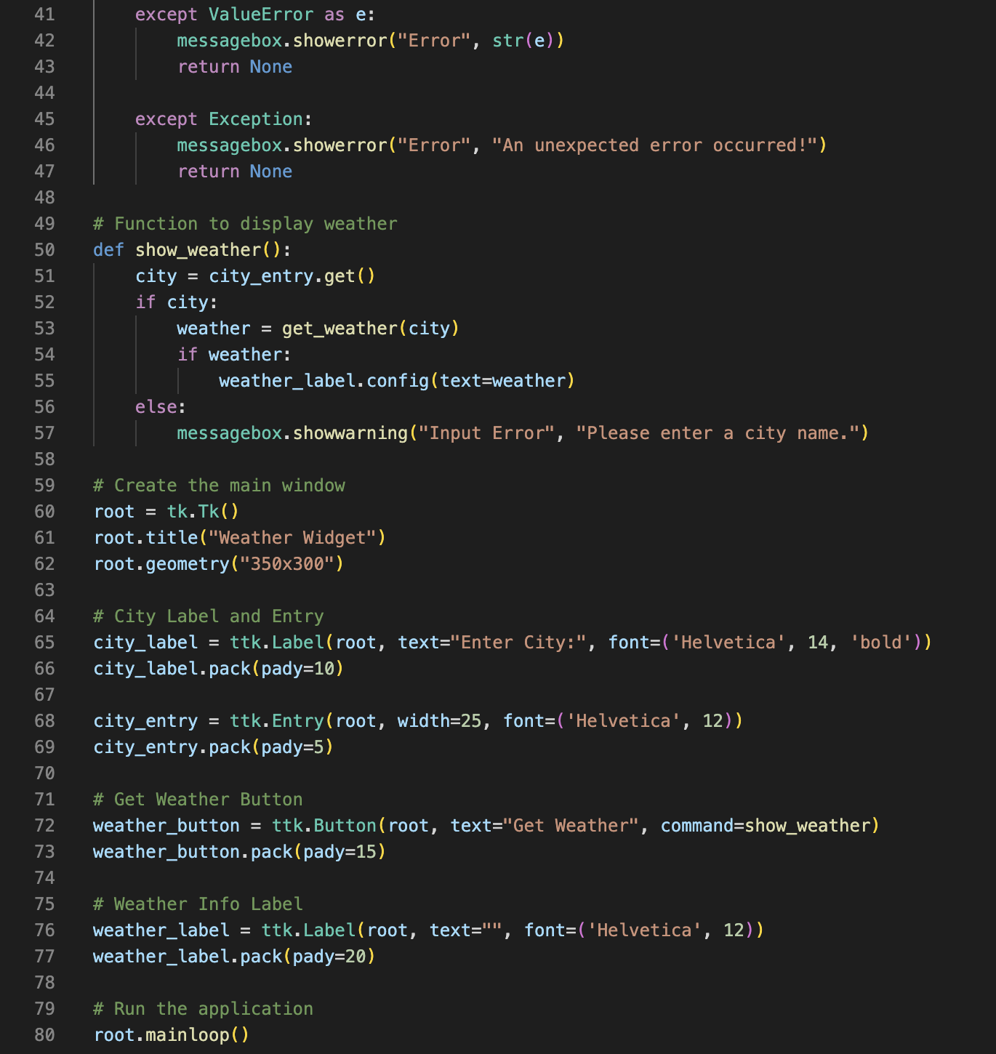
Weather GUi code

Slide 11
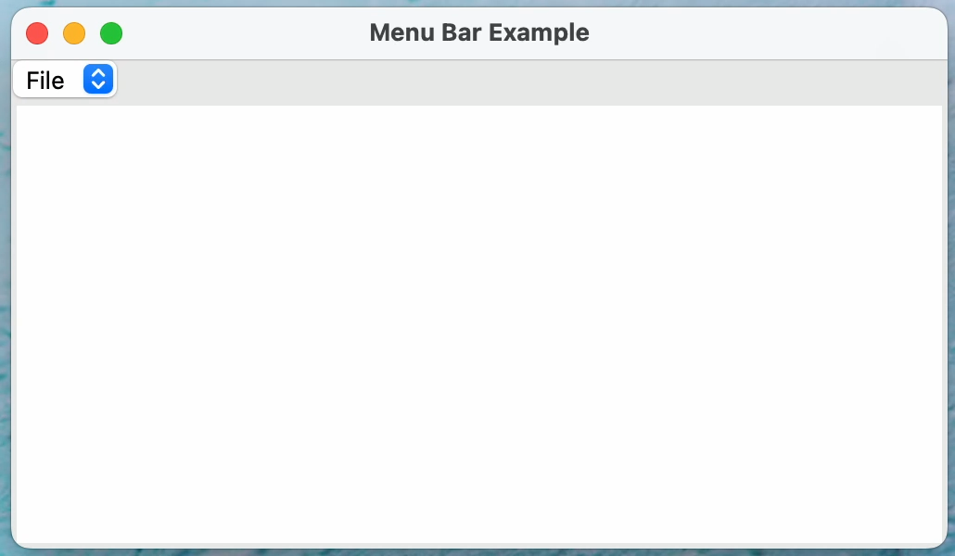
Menu bar GUi Example

Slide 12
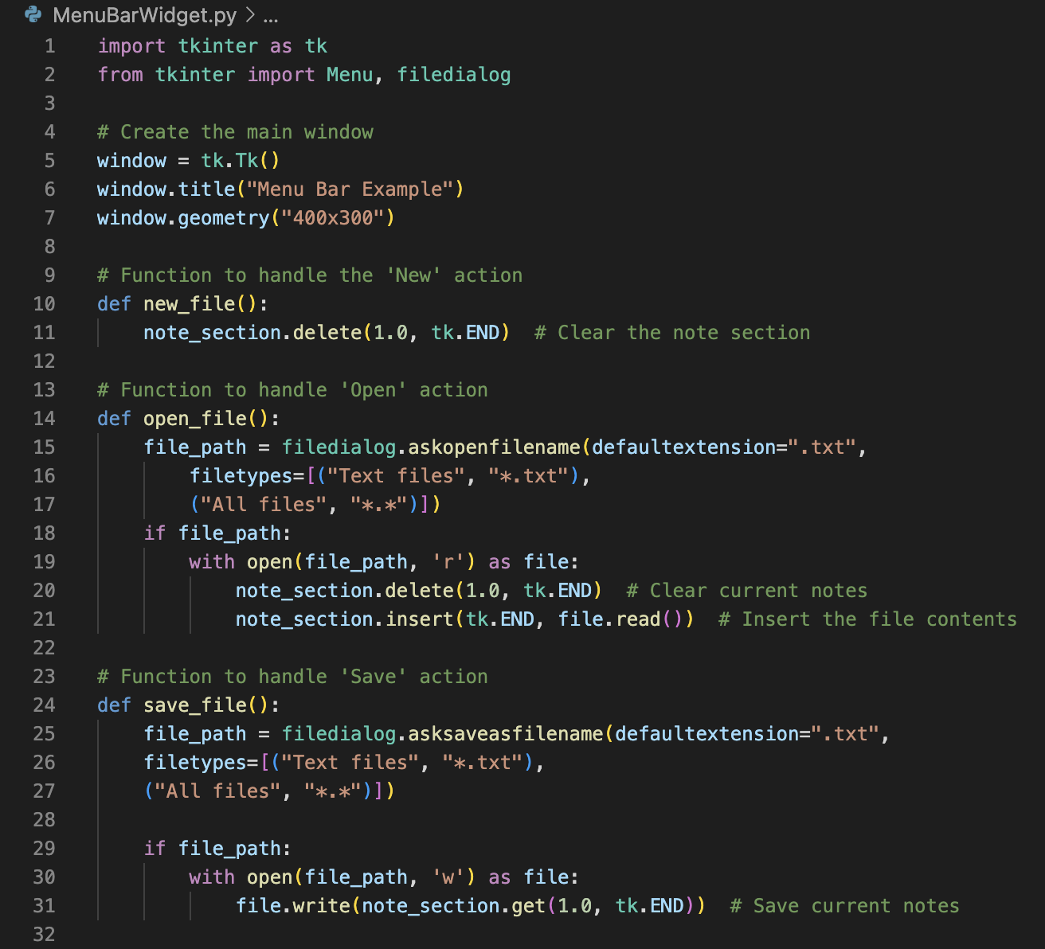
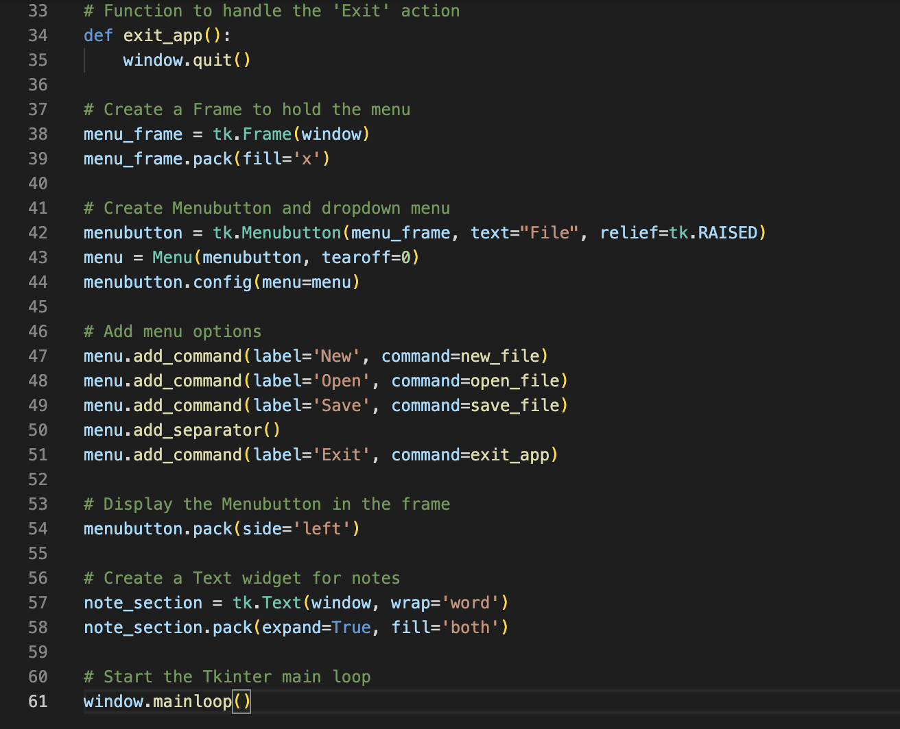
Menu Bar Gui code
Notes:
simple text editor GUI using the tkinter library
window = tk.Tk()
window.title("Menu Bar Example") tk.Tk() initializes the main application window.
add_command: Adds clickable items to the dropdown menu, each linked to a function like new_file, open_file, save_file, or exit_app.
tk.Text(window): Creates a multi-line text widget inside the main window where users can write or edit text mainloop(): Starts the GUI event loop, making the window responsive and enabling user interaction.

Slide 13
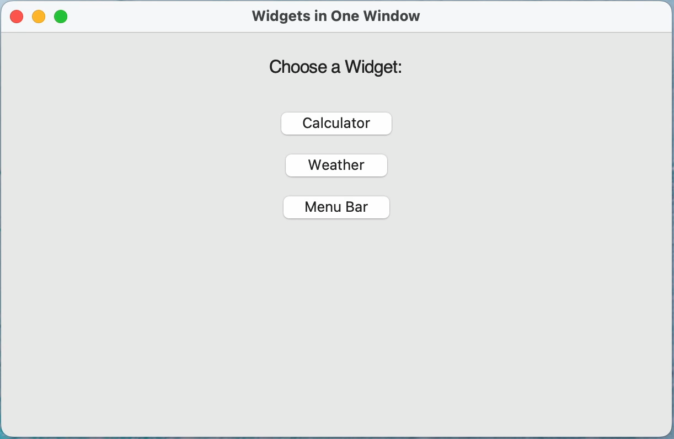
Application with multiple GUIs
Notes:
Frame with a few button widgets.
When the buttons are clicked on, the create the frame that will hold whatever application you want and its widgets, only once.
After that it uses show_ to show whichever application you want.

Slide 14
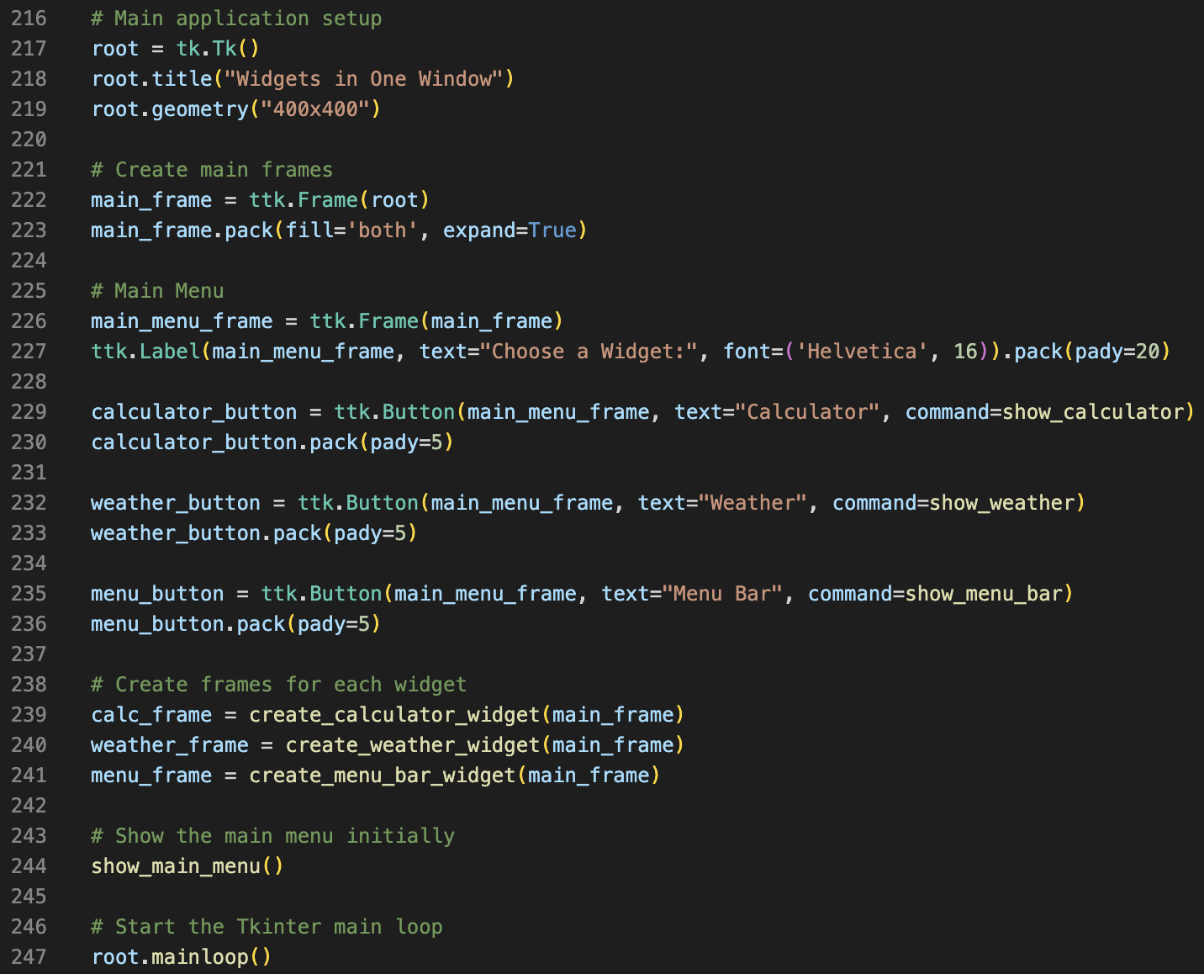
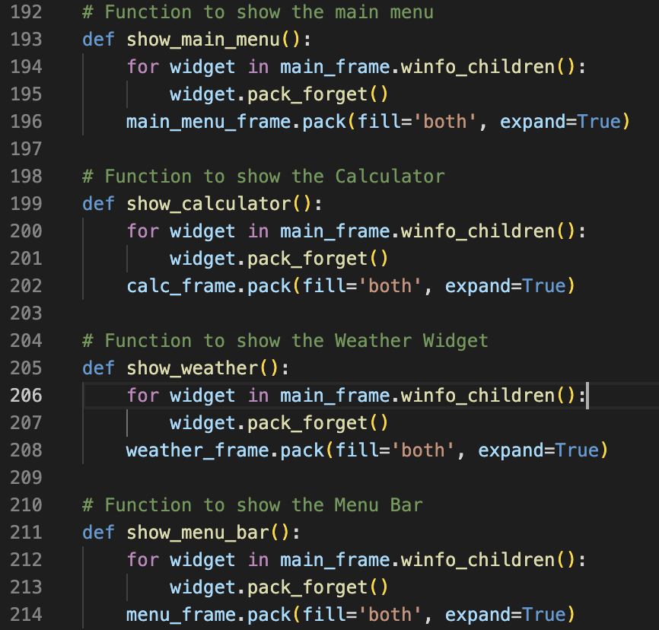
Application with multiple GUIs Code
Notes:
Functions to show a specific frame, since the widgets are only created once.

Slide 15
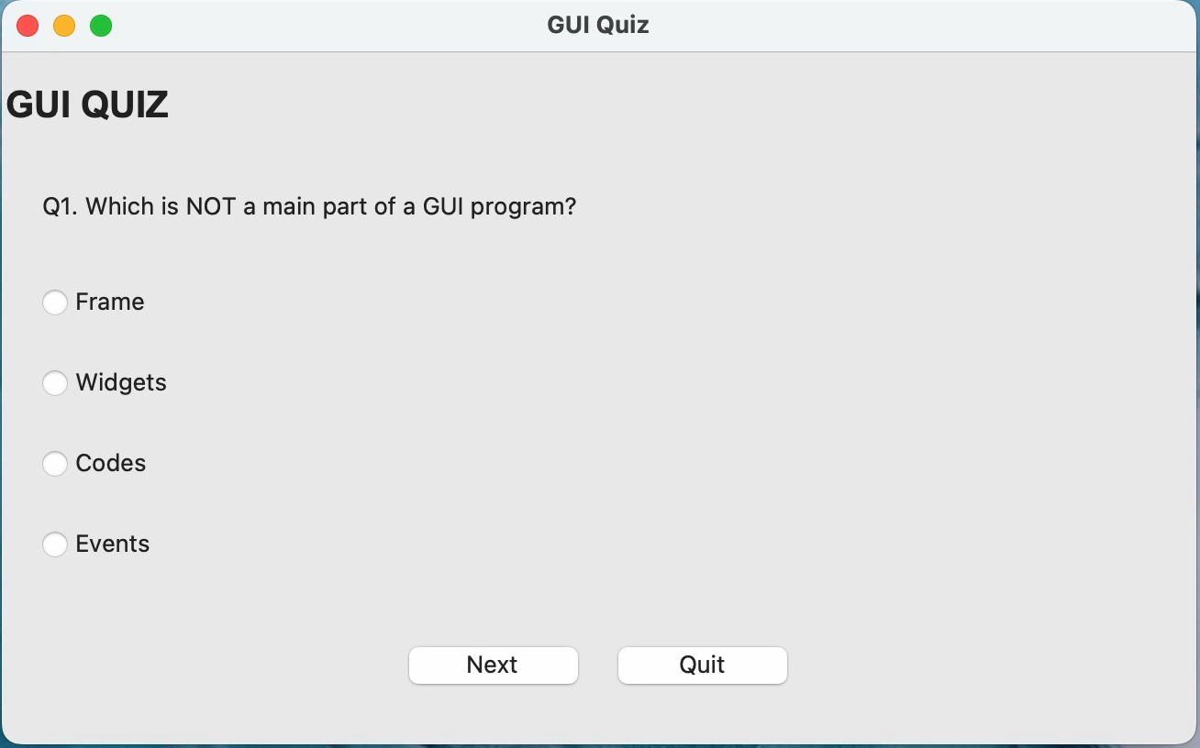
GUI mc quiz

Slide 16
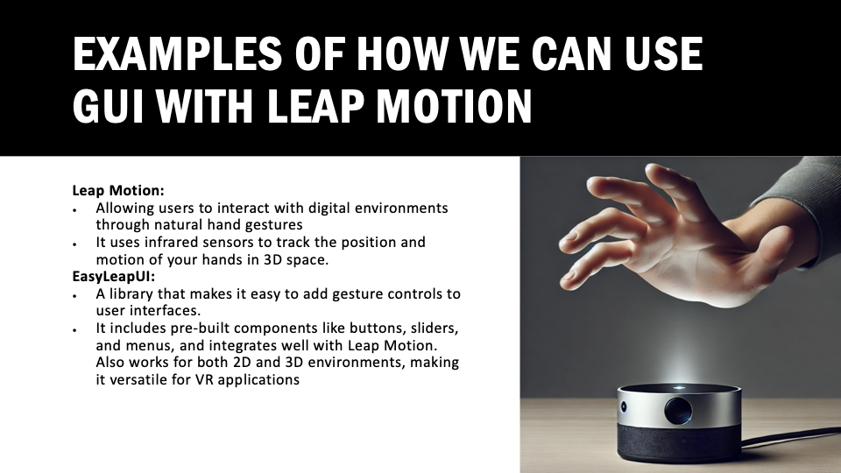

Slide 17
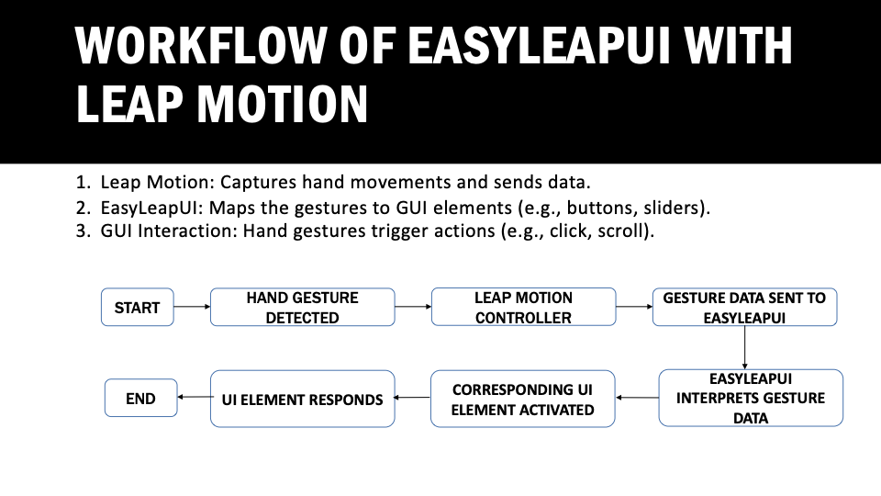

Slide 18
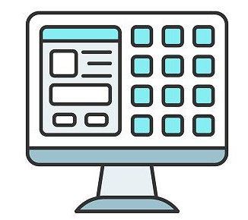
Create your own GUI
Now that the setup is complete and simple examples of a GUI have been shown, it’s your turn to create a GUI!
DELIVERABLE STEPS:
Go through the code available in our Pod 2 repo. Focus on the MCQuizTk.py and AllTkApps.py code.
Follow along and make your own quiz in VS Code.
Modify code so that the answers are displayed in another frame after the quiz is completed. Make the quiz about your workshop and add some stylistic changes.
Submit your modified code and a screen recording of the application working.

Slide 19
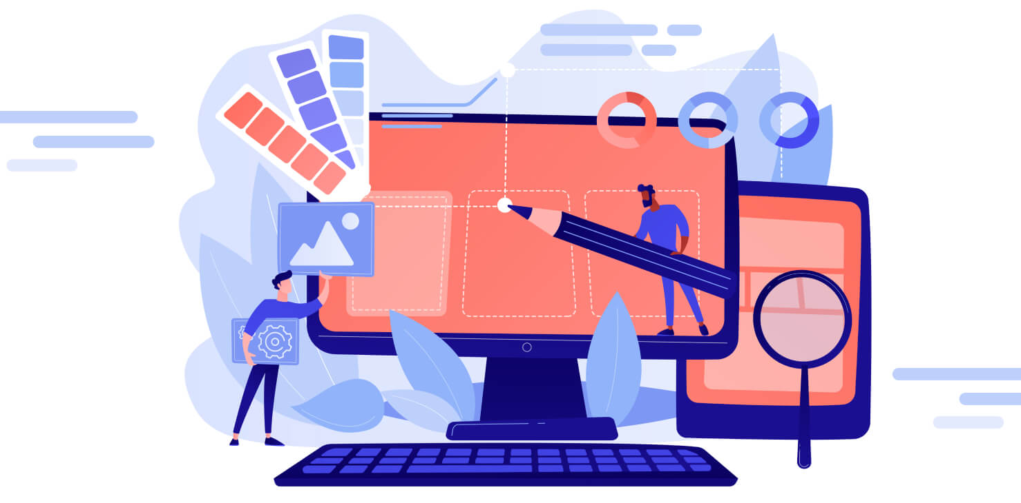
Thank you and good luck on your own Gui's!

